Slide 1
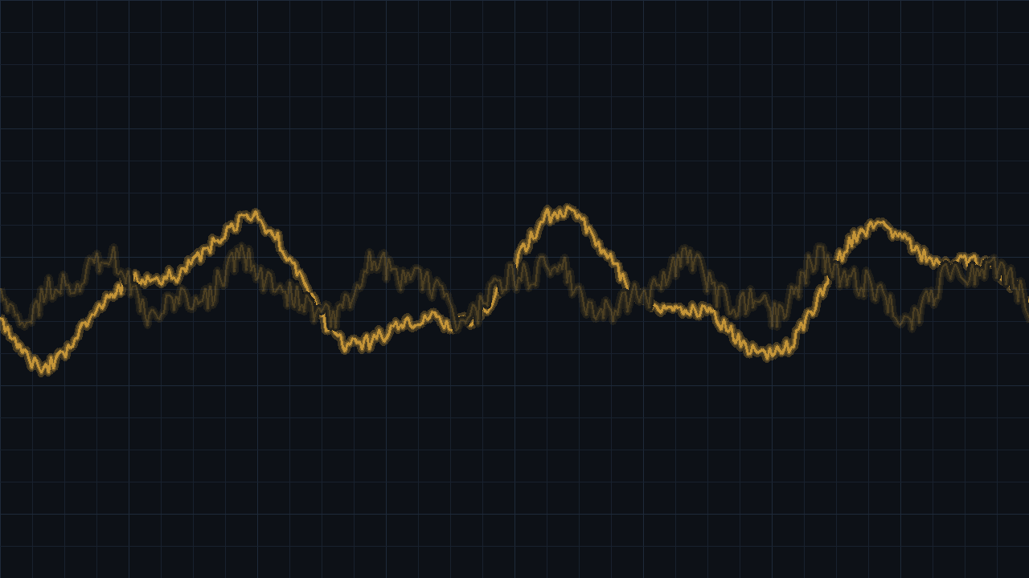
[ PROOF OF CONCEPT · CLASSICAL ML ]
Acoustic
Water-Level Detection
Estimating how full a cup is — from the sound of the pour
COURSE Introduction to Machine Learning · Dr. Dima Bykhovsky
TEAM Or Bastaker · Tamir Grossman · Amit Nigerker · Yuval Holoidovsky
Notes:
Hook with the everyday act of filling a glass and stopping by ear. State the frame: classical ML, proof of concept, no deep learning, no real-time.

Slide 2







00
00 / ROADMAP
How this talk is structured
01
Problem & physics
Why the pour sound carries fill information
02
Data collection
225 controlled recordings across 3 cups
03
Data analysis
Windowed feature extraction → 145 features
04
Pre-processing
Encode labels, stratified split & scaling
05
Training
Feature selection, models, tuning & validation
06
Results
Test accuracy & independent physical check
07
Insights
What worked, what we learned, what’s next
ACOUSTIC WATER-LEVEL DETECTION
02 / 21
Notes:
Give the audience the map. Point out that the middle four sections are exactly what the project brief requires: data collection, data analysis, how it decides, insights.

Slide 3
01
01 / PROBLEM & PHYSICS
Why a pour has a rising pitch
A filling cup is a closing air pipe. As water rises, the air column above it gets shorter — and a shorter resonator rings at a higher frequency. The pour's pitch climbs continuously as the cup fills.
AIR COLUMN SHRINKS AS WATER RISES
f ≈ c / 4L
air column L ↓ ⇒ resonant frequency f ↑
We don't model the physics directly — we let the model learn this acoustic signature from data.
20%
40%
60%
80%
100%
more water → shorter air column → higher pitch
ACOUSTIC WATER-LEVEL DETECTION
03 / 21
Notes:
Explain the physics: the cup is a closing air pipe, f ≈ c/4L; as L shrinks the pitch rises. Stress we don't hand-code this — the model learns the signature. Use the bars to show the shrinking air column.

Slide 4

01
01 / OBJECTIVE & SCOPE
What we set out to build
TASK DEFINITION
GROUND RULES (FROM THE BRIEF)
Input
single-channel audio of a pour
Classical ML only no deep learning / neural nets
Output
one of 5 fill levels
Not real-time offline analysis is acceptable
Classes
20 · 40 · 60 · 80 · 100 %
Proof of concept demonstrate feasibility with numbers
Type
multi-class classification
Classical validation k-fold cross-validation throughout
Check
predicted → physical flow rate
Free tooling any language, libraries and AI tools
ACOUSTIC WATER-LEVEL DETECTION
04 / 21
Notes:
State the task crisply (5-class classification) and the brief's ground rules. The right column shows we respected every constraint.

Slide 5
02
02 / DATA COLLECTION & DATASET
A deliberately controlled dataset
225
3
5
45
recordings
cups
fill levels
per class
HELD CONSTANT ACROSS EVERY TAKE
FORMAT & COMPOSITION
Fixed mic distance identical microphone geometry
Cup sizes
300 / 350 / 400 mL
Quiet room background noise minimised
Per cup
75 recordings
Empty-cup start each pour begins from empty
Duration
1.4 – 20 s
Sample rate
48 / 64 kHz
Water only, uniform flow single liquid, steady tap rate
Balance
perfectly even
ACOUSTIC WATER-LEVEL DETECTION
05 / 21
Notes:
Walk through the recording protocol. Emphasise that the controlled conditions are what make the experiment fair and the strong results meaningful.

Slide 6





03
03 / DATA ANALYSIS
The end-to-end pipeline
01
→
02
→
03
Extract
Encode + split
Scale
145 features
stratified 80/20
fit on train only
04
→
05
→
06
Select
Tune + fit
Evaluate
filter / wrapper
grid-search CV
untouched test set
No data leakage by construction Scaling, feature selection and hyper-parameter tuning are all fitted inside the training fold. The held-out test set is never seen until the final evaluation — so the reported accuracy is honest.
ACOUSTIC WATER-LEVEL DETECTION
06 / 21
Notes:
Walk the pipeline left to right, then hammer the leakage point: scaling/selection/tuning happen inside the training fold; the test set stays untouched.

Slide 7
03
03 / DATA ANALYSIS
Extract
Extract
Encode
Scale
Select
Tune
Evaluate
Every recording becomes a fixed-length numerical fingerprint the model can learn from.
Windowing
Each clip is split into 5 equal time windows, capturing how the pour evolves as the cup fills.
29 features / window
Spectral centroid, rolloff, bandwidth & flatness, RMS energy, zero-crossing rate, 13 MFCCs, onset count, dominant frequency, and more.
145 numbers
5 windows × 29 features, plus deltas between windows — one tidy row per recording.
From clip to row: one short audio file is reduced to a single 145-number feature vector.
ACOUSTIC WATER-LEVEL DETECTION
07 / 21

Slide 8


03
03 / DATA ANALYSIS
From waveform to 145 numbers
Each recording is split into 5 time windows so the model sees how the sound evolves through the pour. Every window is summarised by librosa into 29 features.
Spectral
Energy
Temporal
centroid · roll-off · bandwidth · flatness
RMS energy + delta (Δ)
zero-crossing · onsets · attack · sustain
Source
Pitch
Cepstral
harmonic / percussive ratio
dominant frequency + magnitude
MFCC × 13
1 clip
→
5 windows
→
29 feat / window
→
145 features → 1 CSV row
ACOUSTIC WATER-LEVEL DETECTION
08 / 21
Notes:
Explain windowing (5 windows = temporal evolution) and the six feature families. End on the funnel: 1 clip → 145 features → one CSV row.

Slide 9
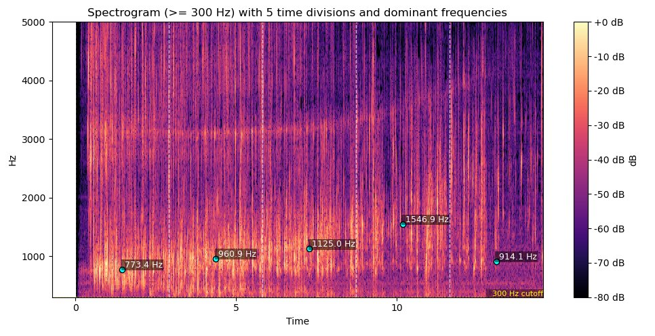
03
03 / DATA ANALYSIS
Watching the pitch climb
READING THE SPECTROGRAM
Dashed lines
split the pour into equal time slices.
Rising pitch
the dominant frequency climbs through the pour (≈770 → 1550 Hz).
Frequency labels
tag the loudest pitch in each slice.
Spectrogram of one pour — dominant frequency marked per time window
ACOUSTIC WATER-LEVEL DETECTION
09 / 21

Slide 10
04
04 / PRE-PROCESSING
Encode + split
Extract
Encode
Scale
Select
Tune
Evaluate
The data is arranged so the model trains and is tested on completely separate recordings.
Label encoding
The five fill levels (0–20% … 80–100%) are mapped to numeric class labels.
Stratified 75/25
A train–test split stratified by class keeps every fill level in the same proportion in both sets.
Why stratify
With ~45 recordings per class, stratification stops any split from under-representing a class.
Honest by design: the test recordings are set aside now and never used during training.
ACOUSTIC WATER-LEVEL DETECTION
10 / 21

Slide 11
04
04 / PRE-PROCESSING
Scale
Extract
Encode
Scale
Select
Tune
Evaluate
Features live on very different numeric ranges, so they are standardised before modelling.
Standardisation
Each feature is rescaled to zero mean and unit variance — a z-score.
Fit on train only
The mean and variance are learned from the training set, then applied to the test set.
No leakage
Fitting on training data alone keeps test information out of the model.
Level playing field: equal scales let every feature contribute fairly, whatever its original units.
ACOUSTIC WATER-LEVEL DETECTION
11 / 21

Slide 12
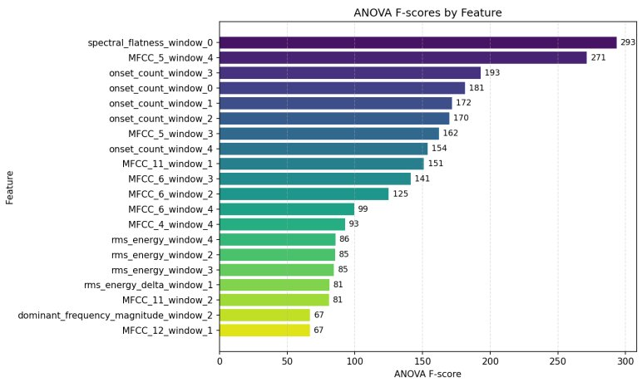
05
05 / TRAINING
Which features actually mattered
READING THE RANKING
spectral_flatness
F = 293 — turbulence of the pour
MFCC_5
F = 271 — timbre of the sound
onset_count
F ≈ 150–193 — splash events
The winners are all physically tied to pouring — confirming the acoustic theory.
ANOVA F-score per feature (higher = better class separation)
ACOUSTIC WATER-LEVEL DETECTION
12 / 21
Notes:
Read the ANOVA chart. The top features — spectral flatness, MFCCs, onset counts — are all physically tied to pouring, which validates the whole approach.

Slide 13
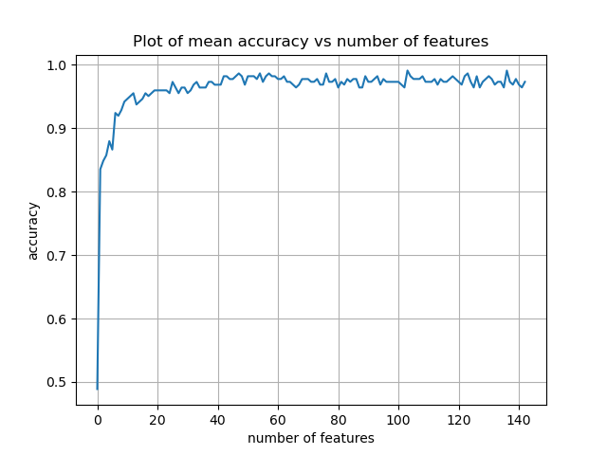
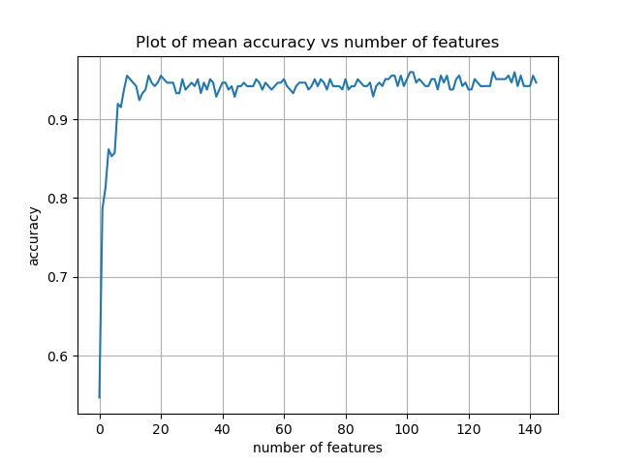
05
05 / TRAINING
How many features do we really need?
Random Forest
XGBoost
WHY IT MATTERS accuracy climbs steeply then flattens out by roughly 20 features — a small, well-chosen subset performs almost as well as all 145.
ACOUSTIC WATER-LEVEL DETECTION

Slide 14


05
05 / TRAINING
Three ways to pick the right features
Extract
Encode
Scale
Select
Tune
Evaluate
Filter
Wrapper
Embedded
MODEL-FREE, FAST
MODEL-SCORED, COSTLY
BUILT INTO TRAINING
Variance threshold
Mutual Information
ANOVA F-test
Rank by strength, drop the weakest.
Forward selection
Backward elimination
Scored by CV accuracy
Add or remove by CV accuracy.
Tree split 'Gain'
XGBoost importance
Random-Forest importance
Scored while the model trains.
Why it helps: fewer, stronger features cut overfitting and speed up training.
ACOUSTIC WATER-LEVEL DETECTION
13 / 21
Notes:
Cover the three classical feature-selection families and what each trades off. We studied all three; filter (ANOVA) is what we show next.

Slide 15
05
05 / TRAINING
Tune + fit
Extract
Encode
Scale
Select
Tune
Evaluate
Each model's hyper-parameters are searched systematically, then the model is trained.
Randomized search
Hyper-parameter combinations are sampled at random from defined ranges — broad coverage at a fraction of a grid’s cost.
Cross-validation
Each combination is scored with k-fold CV on the training data only.
Final fit
The best-scoring configuration is refit on the full training set.
Inside the fold: all tuning happens on training data — the test set is never touched.
ACOUSTIC WATER-LEVEL DETECTION
14 / 21

Slide 16
05
05 / TRAINING
Evaluate
Extract
Encode
Scale
Select
Tune
Evaluate
Performance is measured once, on recordings the model has never seen.
Held-out test
The 25% reserved at the split is scored a single time.
Metrics
Accuracy, macro-F1, precision and recall, plus a confusion matrix per fill level.
Physical check
Predictions are cross-checked against the independent flow-rate estimate.
Credible result: one clean measurement on unseen data is what makes the reported accuracy trustworthy.
ACOUSTIC WATER-LEVEL DETECTION
15 / 21

Slide 17

05
05 / TRAINING
Two tree models, one decision
XGBoost
Random Forest
GRADIENT BOOSTING
BAGGING
Trees added sequentially, each correcting the last; regularised to resist overfitting.
Many de-correlated trees vote; averaging cuts variance and is robust out of the box.
Ensemble — average the two models' class probabilities (0.4 / 0.6) and take the most likely fill class.
Why trees? Tabular features, a small dataset, and free, interpretable feature-importance scores.
ACOUSTIC WATER-LEVEL DETECTION
16 / 21
Notes:
Introduce the two models and why trees suit tabular, small data. Explain the simple probability-averaging ensemble.

Slide 18
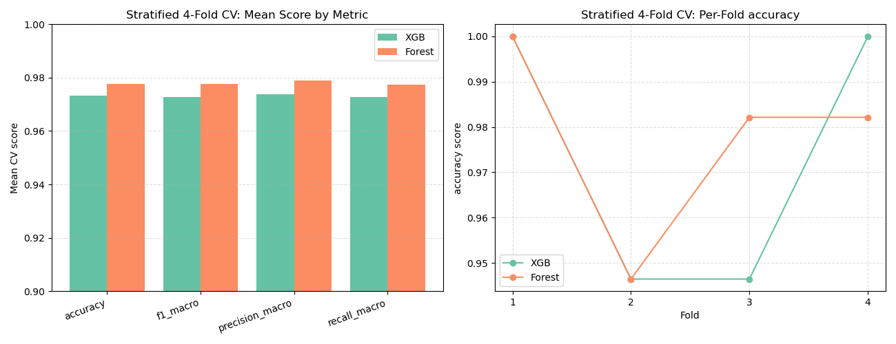
06
06 / RESULTS
Validating performance honestly
Stratified K-Fold
The training set is split into 4 equal folds, each holding the same class balance as the full dataset.
Train on 3 folds, validate on the 4th — rotating until every fold has been held out exactly once.
Every sample is scored just once, always on data the model never saw during training.
Balancing classes in each fold stops a lucky split or a rare class from skewing the result.
4-fold CV: mean score (left) · per-fold accuracy (right)
Random Forest ≈ 98 % mean across accuracy, F1, precision and recall — consistently ahead of XGBoost.
ACOUSTIC WATER-LEVEL DETECTION
17 / 21
Notes:
Explain the validation toolkit and read the CV chart: Random Forest ~98% mean, ahead of XGBoost and stable across folds.

Slide 19
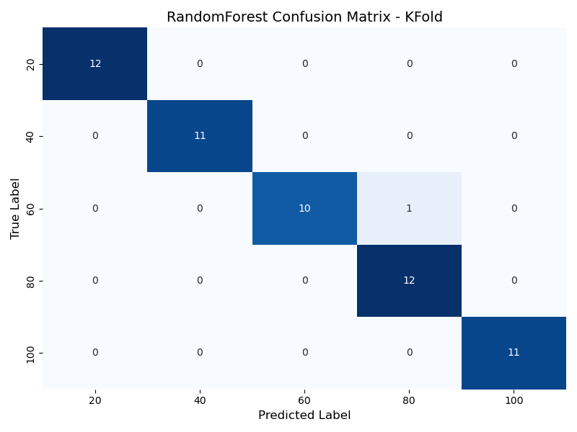
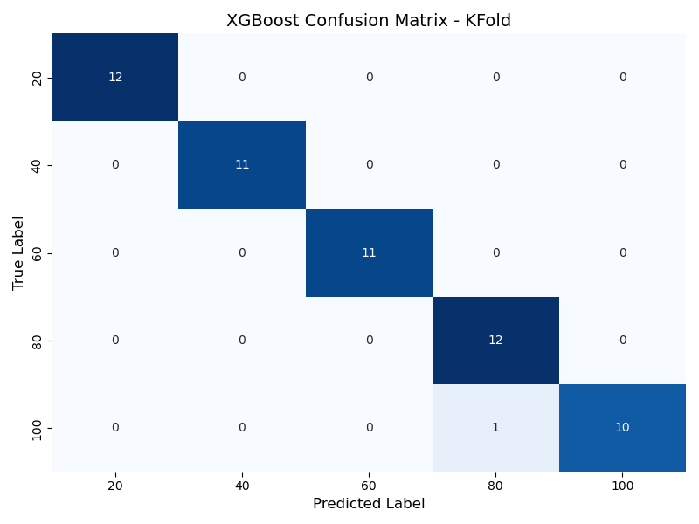
06
06 / RESULTS
Classification on the held-out test set
XGBoost
≈98.25%
Random Forest
≈98.25%
INSIGHT every misclassification lands in an adjacent fill band — never a near-empty vs. near-full mix-up.
ACOUSTIC WATER-LEVEL DETECTION
18 / 21
Notes:
Show the two confusion matrices on the 45-sample test set: XGBoost ~89%, Random Forest perfect. Key insight: errors are always to a neighbouring band.

Slide 20
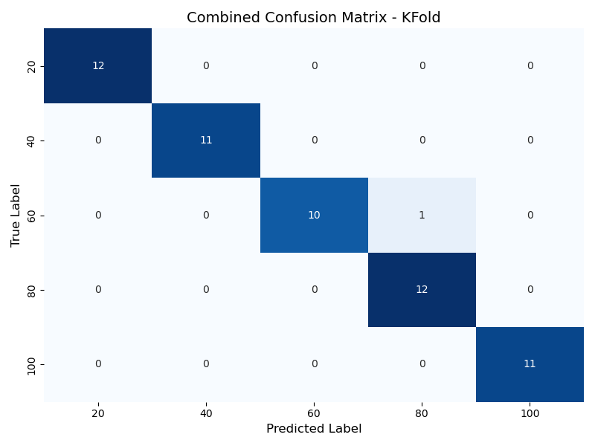
06
06 / RESULTS
Cross-validated performance
Confusion matrix
≈98.25%
Classification report
prec rec f1 n
20 1.00 1.00 1.00 12
40 1.00 1.00 1.00 11
60 1.00 0.91 0.95 11
80 0.92 1.00 0.96 12
100 1.00 1.00 1.00 11
accuracy 0.98 57
macro avg 0.98 0.98 0.98 57
weighted 0.98 0.98 0.98 57
READING IT every class scores at least 0.95 F1; the only errors fall between neighbouring fill levels (60 ↔ 80).
ACOUSTIC WATER-LEVEL DETECTION

Slide 21
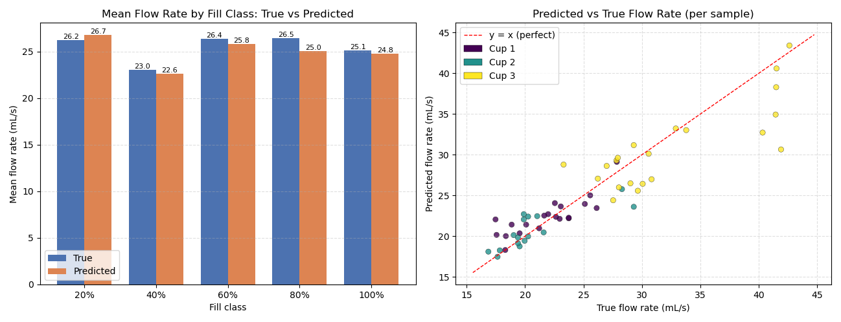
06
06 / RESULTS
An independent physical check
flow rate = (fill % × cup capacity) / duration
Turning predicted fill into a physical flow rate gives a second, independent check — and predicted matches true almost exactly.
ACCURACY BY CLASS
20 %
98.12 %
40 %
98.26 %
60 %
97.72 %
80 %
94.34 %
100 %
98.80 %
97.45 %
Average
Mean flow rate by cup (left) · per-sample predicted vs. true on y = x (right)
ACOUSTIC WATER-LEVEL DETECTION
19 / 21
Notes:
Physical sanity check: convert predicted fill to flow rate; predicted equals true to the decimal per cup. This is evidence beyond accuracy.

Slide 22
06
06 / COMPLETE WORKFLOW
Every stage, end to end
PHASE 1
Recordings → dataset
Recordings
→
5 time windows
→
Frequency analysis
→
Window deltas Δ
→
Dataset
29 features × 5 windows = 145 · spectral centroid/rolloff/bandwidth/flatness · RMS+Δ · ZCR · MFCC×13 · dominant freq · onsets · H/P ratio · envelope
PHASE 2
Model pipeline
Load dataset
→
Preprocess
→
ANOVA / F1
→
Configure model
→
Train & validate
drop · encode · scale · split | FFS · hyper-param tuning · accuracy-vs-features | k-fold CV · confusion matrix · metric report
PHASE 3
Combine 2 models
XGBoost + RF
→
Compare results
→
Combine probabilities
→
Final test
→
Metric report
average the two models’ class probabilities (0.5 / 0.5) → most-likely fill class
PHASE 4
Flow-rate prediction
Train regression
→
Pick best model
→
Predict flow rate
→
Graph results
independent physical cross-check · flow rate = (fill % × cup capacity) / duration
ACOUSTIC WATER-LEVEL DETECTION
20 / 21

Slide 23

07
[ 07 / INSIGHTS · CONCLUSION ]
What we learned
Physics-driven features win
Simple can beat fancy
Flatness & onsets — pouring cues — topped the ranking.
Random Forest matched/beat tuned XGBoost here.
Validation discipline
Numbers, not vibes
K-Fold + leave-one-cup-out kept scores leak-free.
Flow-rate agreement physically confirms predictions.
Conclusion A classical-ML acoustic level sensor works — up to 98% test accuracy, ~96% CV, errors only adjacent. We ran it end to end – from gathering the recordings, through preprocessing, to training the models on the data.
Notes:
Close with the four insights and the conclusion. End on next steps — real-time, noise, more liquids/cups — i.e. the engineering-project extension.

